Slide 1
Survival Prediction for Gastric Cancer via
Multimodal Learning of Whole Slide Images and
Gene Expression
Authour: Yuzhang Xie, Guoshuai Niu, Qian Da, Wentao Dai, and Yang Yang∗

Slide 2
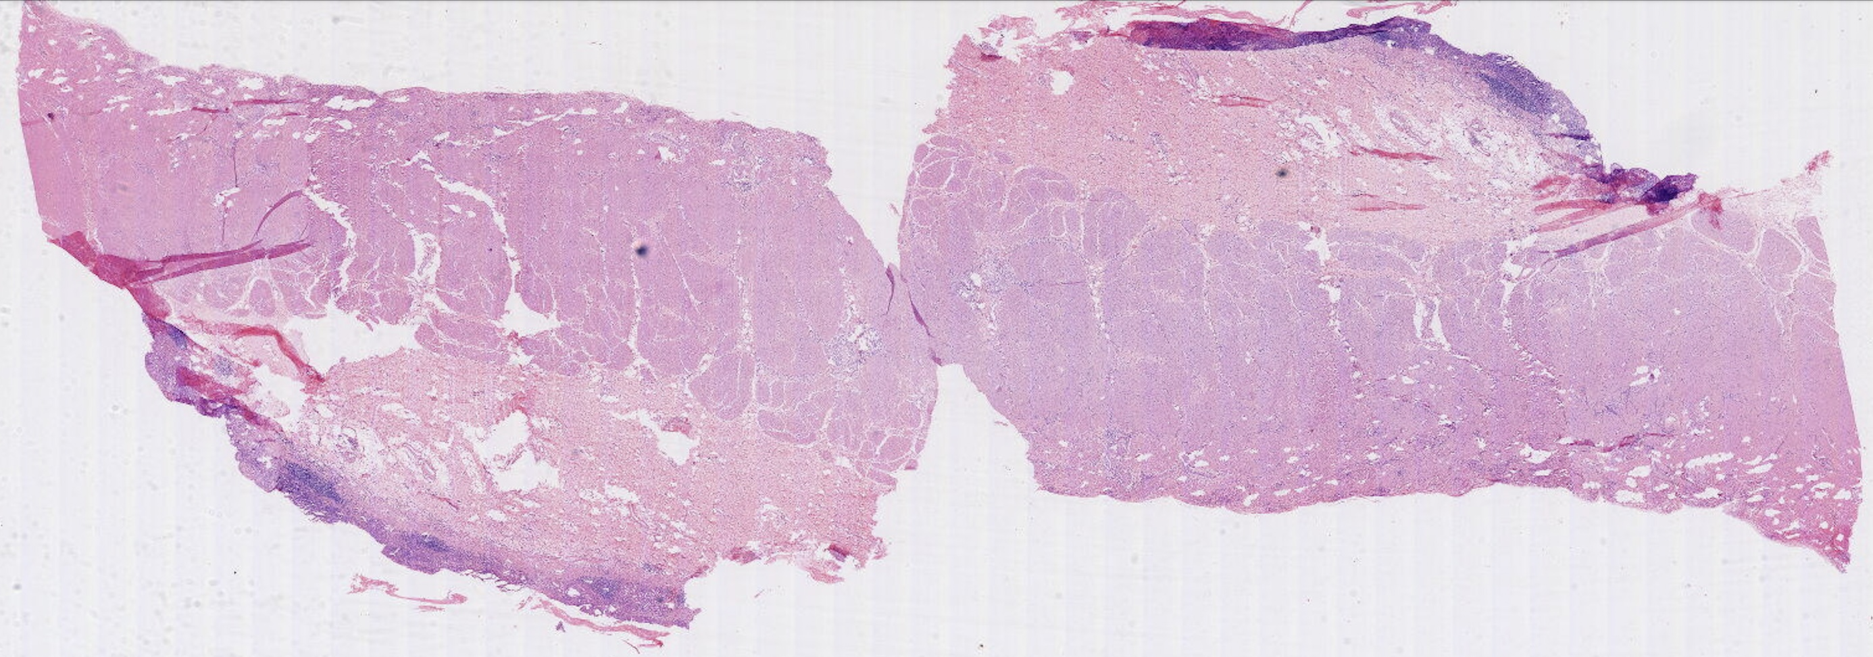
WSIs for diagnosis
Whole slide images (WSIs) are gold standard for the diagnosis of many cancer types, including Gastric Cancer (GC) [1]

Slide 3
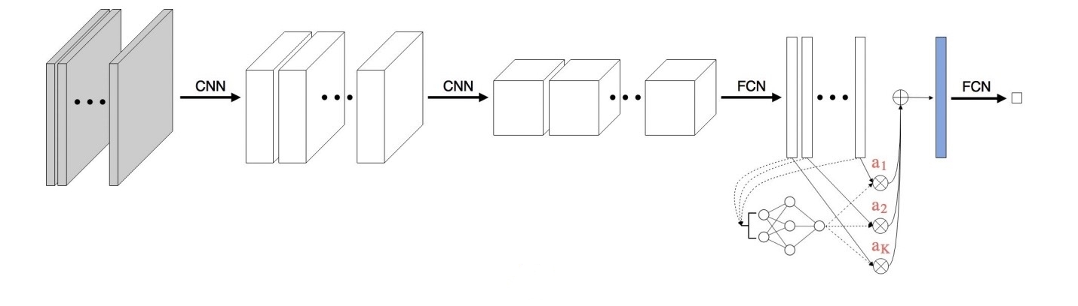
WSIs for diagnosis
AttentionMIL [2]
segmentation
CNN
attention
Patch-level representations
WSI-level representations
WSI
Patches

Slide 4
WSIs for diagnosis
AttnMIL[2]
Adding different modules, such as CLAM [3]

Slide 5
WSIs for diagnosis
AttnMIL[2]
Adding different modules, such as CLAM [3]
Performance could be improved by adding complementary information from patients

Slide 6
Multimodal learning for diagnosis
Gene expression is also regarded as an important data source for diagnosis [4]
With multimodal learning models, gene expression data can be integrated with WSIs, thus providing supplementary information
gene | value
MMP13 | 4.074
STAT3 | 9.963
... | ...
gene | value
MMP13 | 4.074
STAT3 | 9.963
... | ...
gene | value
MMP13 | 4.074
STAT3 | 9.963
... | ...
Gene | Value
MMP13 | 4.074
STAT3 | 9.963
... | ...

Slide 7
Multimodal learning for diagnosis
MCAT: based on the cross-modal attention mechanism and attention pooling mechanism to fuse embedding vectors from whole-slide images and omics data [5]
gene | value
MMP13 | 4.074
STAT3 | 9.963
... | ...
gene | value
MMP13 | 4.074
STAT3 | 9.963
... | ...
gene | value
MMP13 | 4.074
STAT3 | 9.963
... | ...
Gene | Value
MMP13 | 4.074
STAT3 | 9.963
... | ...

Slide 8
Multimodal learning for diagnosis
MCAT: based on the cross-modal attention mechanism and attention pooling mechanism to fuse embedding vectors from whole-slide images and omics data [5]
Could not handle incomplete dataset.

Slide 9
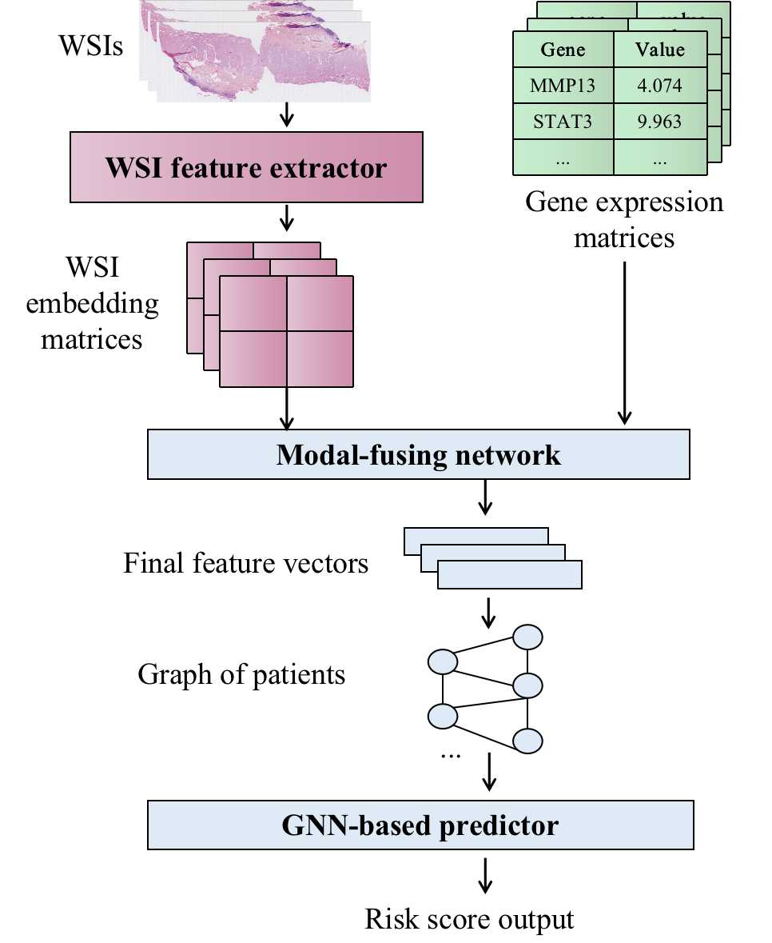
GC-SPLeM model
(Gastric Cancer Survival
Prediction via Learning Multimodal data)

Slide 10
GC-SPLeM model

Slide 11
GC-SPLeM model

Slide 12
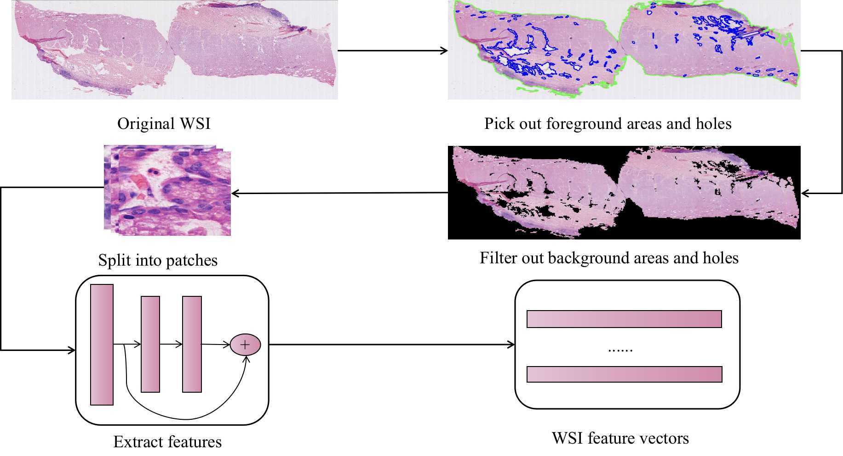
WSI feature extractor

Slide 13
WSI feature extractor
Concatenate feature vectors from different whole-slide-images of a patient
Conduct WSI feature extraction process ahead of training other parts of our model

Slide 14
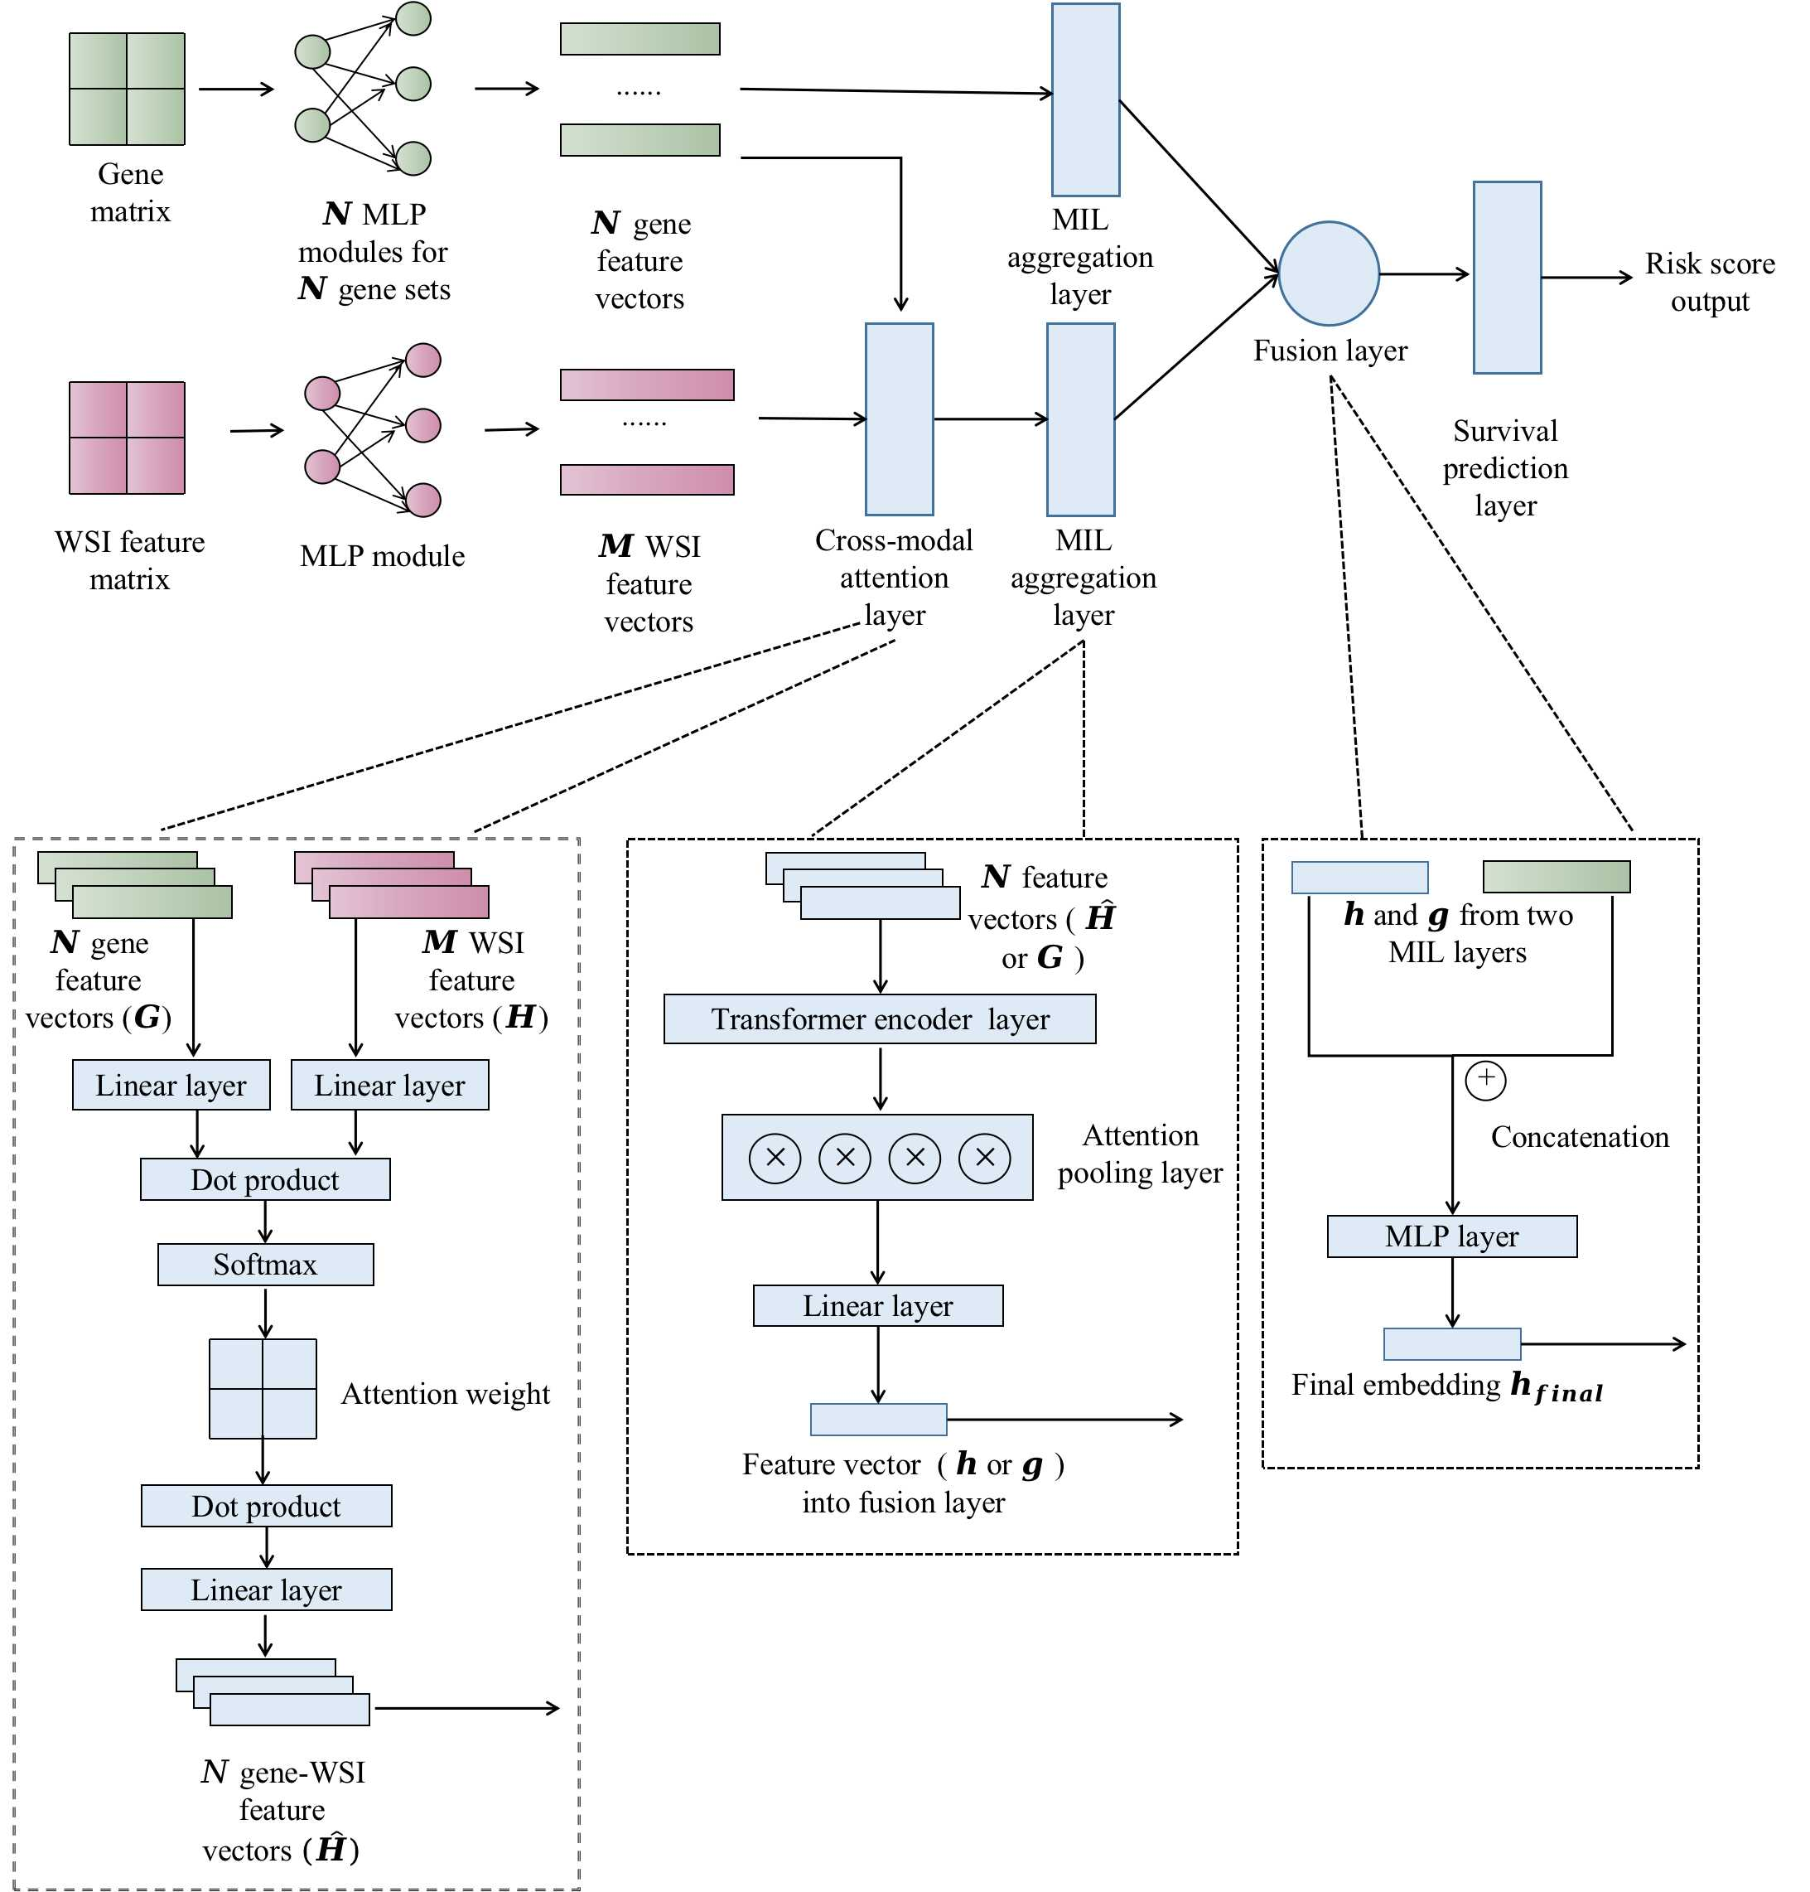
Modal-fusing network

Slide 15
Gene feature extraction layer
Modal-fusing network

Slide 16
WSI feature extraction layer
Modal-fusing network

Slide 17
Modal-fusing network
Cross-modal attenion layer [6]
Generate a WSI-gene-incorporated feature matrix

Slide 18
Modal-fusing network
Multi-instance aggregation layer

Slide 19
Modal-fusing network
Fusion layer

Slide 20

Survival prediction layer
Modal-fusing network
Final embedding $h_{final}$

Slide 21
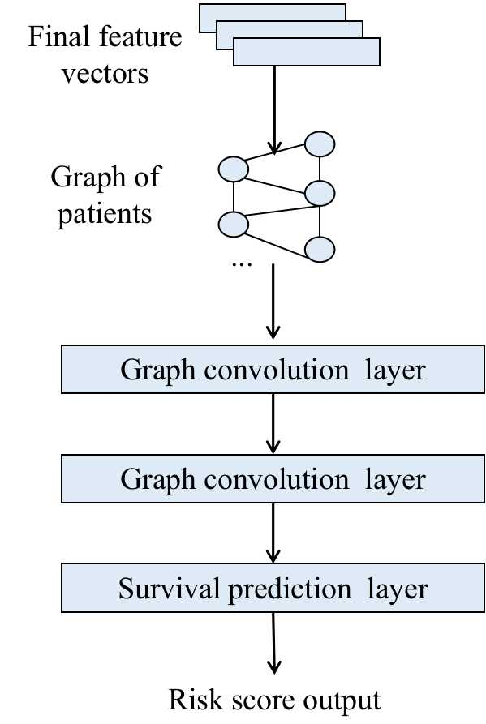
GNN-based predictor

Slide 22

Feature vector $h_{final}$
GNN-based predictor

Slide 23
GNN-based predictor
KNN graph
Each node represents a patient
Distance between two nodes is measured according to cosine distance of feature vectors
Each node is connected with 4 nearst neighbors

Slide 24
GNN-based predictor

Slide 25
Model summary: aggregating multimodal features

Slide 26
Model summary: aggregating multimodal features
Fusion layer
Cross-modal attenion layer

Slide 27
Model summary: graph of patients
Novelty: As far as we know, this is the first work that builds a graph of patients in datasets for survival prediction.
Motivation: Patients with close WSI and gene expression data are highly possible to have similar survival outcomes.
Missing modality problem: Learning from the neighborhood of a patient could be helpful to enhance its representation.

Slide 28
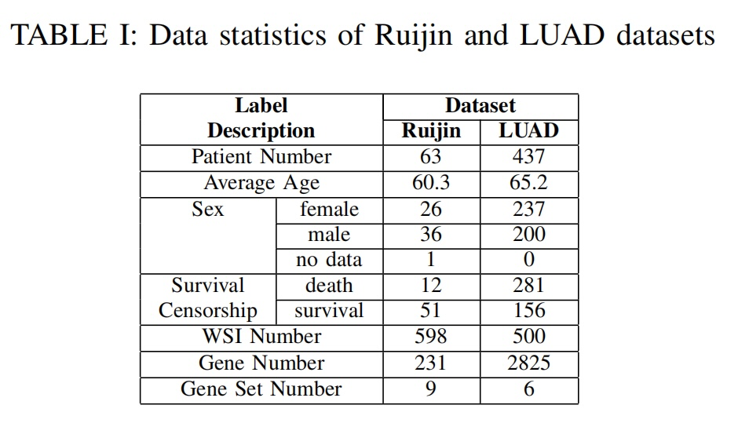
Dataset Description

Slide 29
Dataset Description

Slide 30
Comparing methods
1. GC-SPLeM
2. MCAT (WSI + gene)
3. CLAM (WSI-only)
4. GC-SPLeM without GNN

Slide 31
Performance evaluation
1. Harrell’s C-index [6]
2. Five splits’ average C-index
3. Stratified splitting

Slide 32
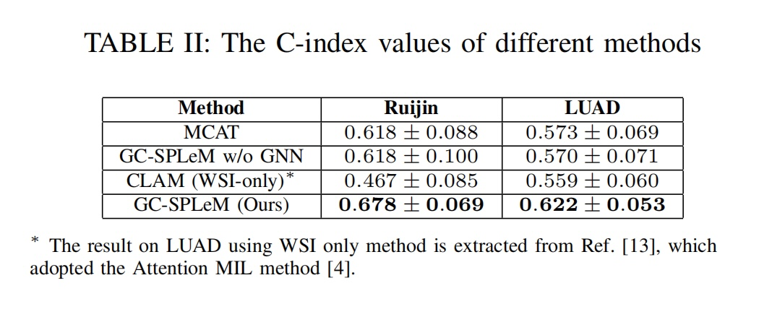
Performance comparison on complete data

Slide 33
Ablation study: Training an incomplete dataset
Original value
50% samples of training set
Incomplete dataset with modality missing
Replaced by random values following normal distribution
gene | value
MMP13 | 4.074
STAT3 | 9.963
... | ...
gene | value
MMP13 | 4.074
STAT3 | 9.963
... | ...
gene | value
MMP13 | 4.074
STAT3 | 9.963
... | ...
Gene | Value
MMP13 | 4.074
STAT3 | 9.963
... | ...
Others
Original value

Slide 34
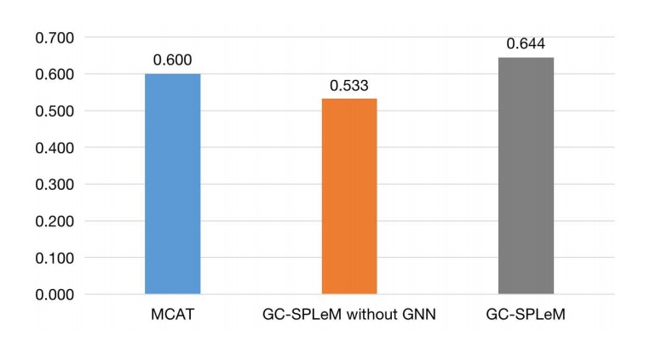
Performance comparison on incomplete data
Figure: C-index value comparison of three methods on the
incomplete Ruijin dataset

Slide 35
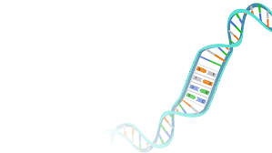
Performance comparison on incomplete data
Modality missing problem
discard samples with incomplete modalities
apply GC-SPLeM to the incomplete datasets
missing modality

Slide 36
Summary of experiments
Complete dataset
GC-SPLeM
Incomplete dataset
Other diseases

Slide 37
Contributions
1. GC-SPLeM and its great performance
2. The graph of patients lift the performance and alleviate the modality missing problem
3. Application to other diseases and datasets

Slide 38
Future works
1. Validate and improve the graph of patients
2. Improve the feature extraction network
3. Picking out more useful genes
4. Other GC diagnosis-related tasks

Slide 39
Reference
[1] Gurcan, Metin N, et al., “Histopathological image analysis: a review,” IEEE reviews in biomedical engineering vol.2: 147-71, 2009.
[2] Maximilian Ilse, Jakub Tomczak, and Max Welling, “Attention-based deep multiple instance learning,” 35th International Conference on Machine Learning 2018, 80: 2127-2136.
[3] Ming Y Lu, Drew FK Williamson, Tiffany Y Chen, Richard J Chen, Matteo Barbieri, and Faisal Mahmood, “Data efficient and weakly supervised computational pathology on whole slide images,” Nature Biomedical Engineering 2020, 5: 555–570
[4] Richard J. Chen, Ming Y. Lu, Wei-Hung Weng, Tiffany Y. Chen, Drew FK. Williamson, Trevor Manz, et al., “Multimodal Co-Attention Transformer for Survival Prediction in Gigapixel Whole Slide Images,” Proceedings of the IEEE/CVF International Conference on Computer Vision, 2021.
[5] Narrandes, Shavira, and Wayne Xu, “Gene Expression Detection Assay for Cancer Clinical Use,” Journal of Cancer vol. 9,13 2249-2265. 5 Jun. 2018.
[6] Schmid, Matthias, Marvin N. Wright, and Andreas Ziegler, “On the use of Harrell’s C for clinical risk prediction via random survival forests,” Expert Systems with Applications, 63: 450-459, 2016.

Slide 40



Acknowledgement
This work was supported by the National Natural Science Foundation of China (No. 61972251, 62272300, and 32000472).
This is a joint work of Shanghai Jiao Tong University, Ruijin Hospital of Shanghai Jiao Tong University School of Medicine, and Shanghai Institute for Biomedical and Pharmaceutical Technologies.

Slide 41
Thank you for your listening !

